Slide 1
Capstone Project The Battle of Neighborhoods Presentation Mohd Shakir JUNE ,2021

Slide 2
Introduction 1)Background-Safety is a top concern when moving to a new area. If you don’t feel safe in your own home, you’re not going to be able to enjoy living there. 2)Problem-This project aims to select the safest borough in London based on the total crimes, explore the neighborhoods of that borough to find the 10 most common venues in each neighborhood and finally cluster the neighborhoods using k-mean clustering. 3)Interest-Expats who are considering to relocate to London will be interested to identify the safest borough in London and explore its neighborhoods and common venues around each neighborhood

Slide 3
Data Acquisition and Cleaning Data Acquisition -The data acquired for this project is a combination of data from three sources. 1)The first data source of the project uses a ​London crime data​ that shows the crime per borough in London. 2)The second source of data is scraped from a wikipedia page that contains the list of London boroughs​. This page contains additional information about the boroughs, the following are the columns 3)The third data source is the ​list of Neighborhoods in the Royal Borough of Kingston upon Thames​ as found on a wikipedia page.

Slide 4
Data Cleaning The data preparation for each of the three sources of data is done separately. 1) From the London crime data, the crimes during the most recent year (2016) are only selected. The major categories of crime are pivoted to get the total crimes per the boroughs for each major category 2) The second data is scraped from a wikipedia page using the ​Beautiful Soup​ library in python. Using this library we can extract the data in the tabular format as shown in the website 3) The two datasets are merged on the Borough names to form a new dataset that combines the necessary information in one dataset (see ​fig 2.3​). The purpose of this dataset is to visualize the crime rates in each borough and identify the borough with the least crimes recorded during the year 2016. 4) After visualizing the crime in each borough we can find the borough with the lowest crime rate and hence tag that borough as the safest borough. The third source of data is acquired from the list of neighborhoods in the safest borough on Wikipedia 5) The new dataset is used to generate the 10 most common venues for each neighborhood using the Foursquare API, finally using k means clustering algorithm to cluster similar neighborhoods together

Slide 5
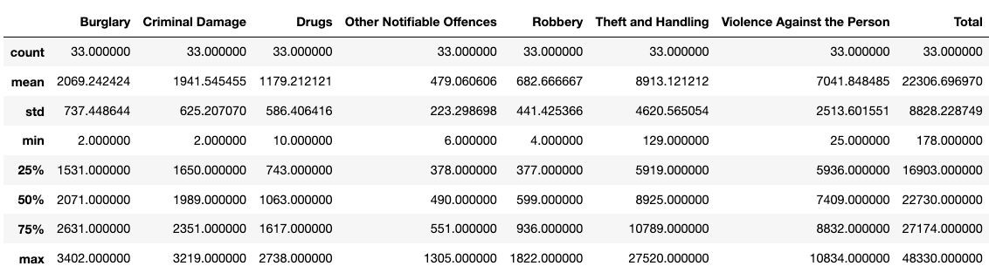
Methodology Exploratory Data Analysis Statistical summary of crimes The count for each of the major categories of crime returns the value 33 which is the number of London boroughs. ‘Theft and Handling’ is the highest reported crime during the year 2016 followed by ‘Violence against the person’, ‘Criminal damage’. The lowest recorded crimes are ’Drugs’, ‘Robbery’ and ‘Other Notifiable offenses’.

Slide 6
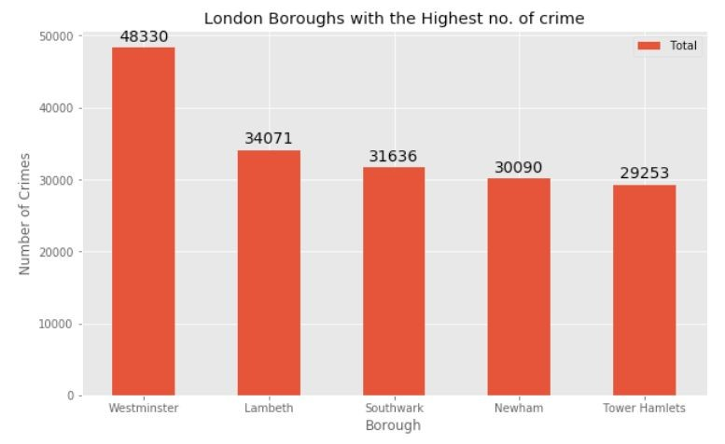
Boroughs with the highest crime rates Comparing five boroughs with the highest crime rate during the year 2016 it is evident that Westminster has the highest crimes recorded followed by Lambeth, Southwark, Newham and Tower Hamlets. Westminster has a significantly higher crime rate than the other 4 boroughs

Slide 7
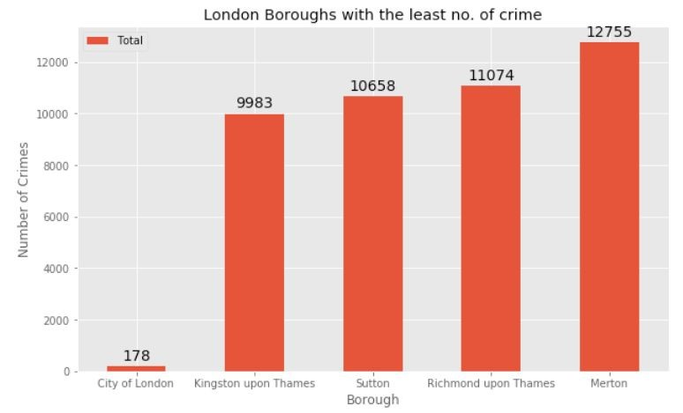
Boroughs with the lowest crime rates Comparing five boroughs with the lowest crime rate during the year 2016, City of London has the lowest recorded crimes followed by Kingston upon Thames, Sutton, Richmond upon Thames and Merton City of London has a significantly lower crime rate because it i is the 33rd principal division of Greater London but it is not a London borough. It has an area of 1.12 square miles and a population of 7000 as of 2013 which suggests that it is a small area we will consider the next borough with the lowest crime rate as the safest borough in London which is Kingston upon Thames.

Slide 8
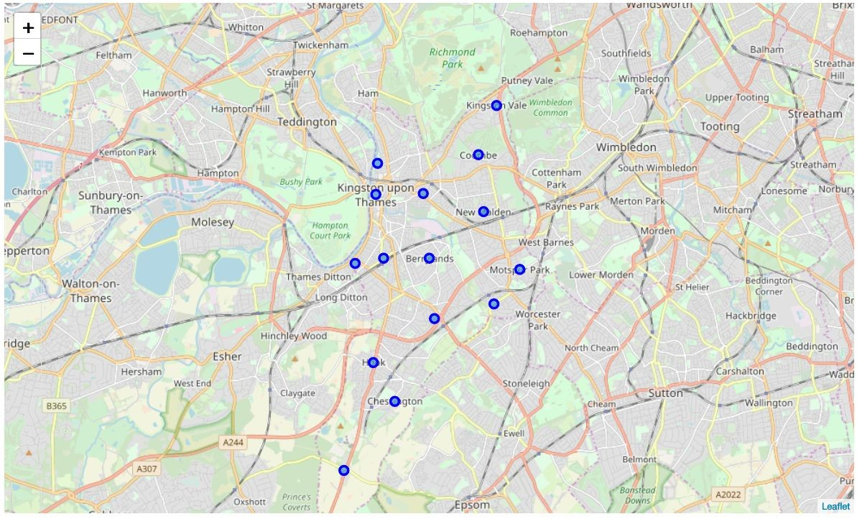
Neighborhoods in Kingston upon Thames There are 15 neighborhoods in the royal borough of Kingston upon Thames, they are visualised on a map using folium on python

Slide 9
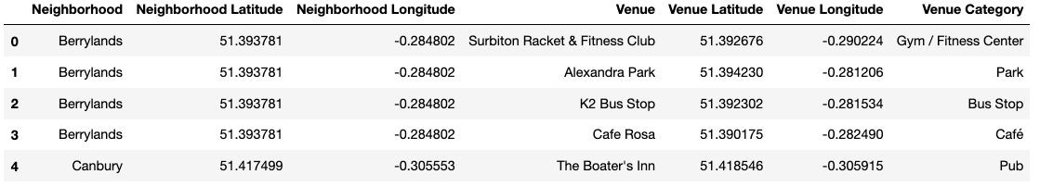
Modelling Using the final dataset containing the neighborhoods in Kingston upon Thames along with the latitude and longitude, we can find all the venues within a 500 meter radius of each neighborhood by connecting to the Foursquare API. One hot encoding is done on the venues data The Venues data is then grouped by the Neighborhood and the mean of the venues are calculated, finally the 10 common venues are calculated for each of the neighborhoods. To help people find similar neighborhoods in the safest borough we will be clustering similar neighborhoods using K - means clustering which is a form of unsupervised machine learning algorithm that clusters data based on predefined cluster size. We will use a cluster size of 5 for this project that will cluster the 15 neighborhoods into 5 clusters. The reason to conduct a K- means clustering is to cluster neighborhoods with similar venues together so that people can shortlist the area of their interests based on the venues/amenities around each neighborhood.

Slide 10
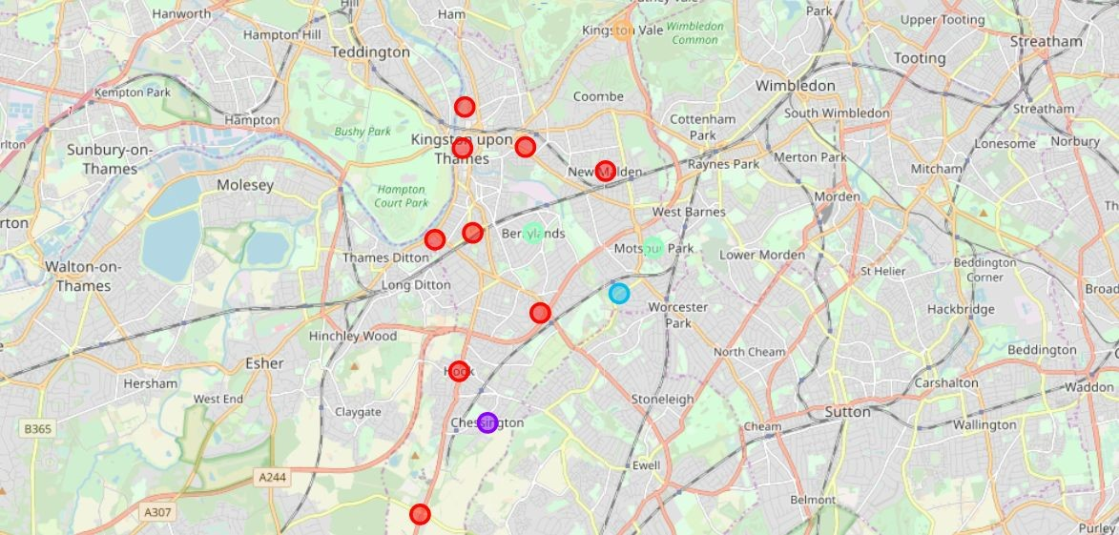
Results After running the K-means clustering we can access each cluster created to see which neighborhoods were assigned to each of the five clusters. Visualising the clustered neighborhoods on a map using the folium library Each cluster is color coded for the ease of presentation, we can see that majority of the neighborhood falls in the red cluster which is the first cluster. Three neighborhoods have their own cluster (Blue, Purple and Yellow), these are clusters two three and five. The green cluster consists of two neighborhoods which is the 4th cluster.

Slide 11
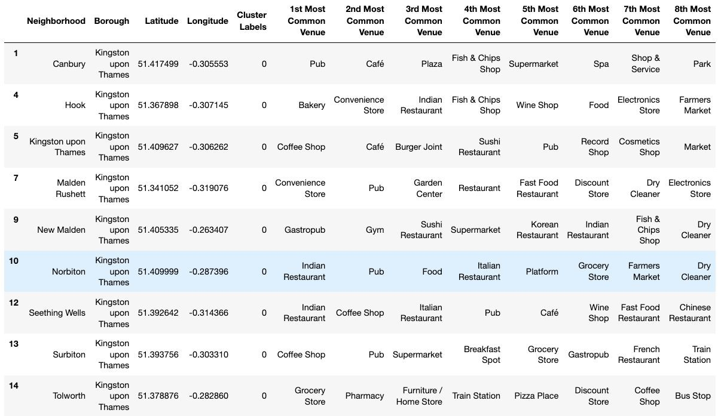
Cluster 1:Looking into the neighborhoods in the first cluster The cluster one is the biggest cluster with 9 of the 15 neighborhoods in the borough Kingston upon Thames. Upon closely examining these neighborhoods we can see that the most common venues in these neighborhoods are Restaurants, Pubs, Cafe, Supermarkets, and stores

Slide 12
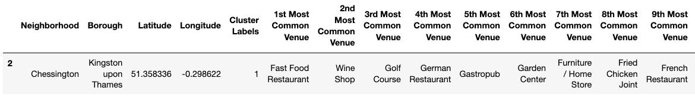
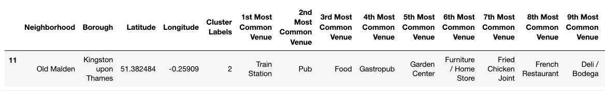
Cluster 2:Looking into the neighborhoods in the second Cluster The second cluster has one neighborhood which consists of Venues such as Restaurants, Golf courses, and wine shops Cluster 3:Looking Into the neighborhoods in the third Cluster The third cluster has one neighborhood which consists of Venues such as Train stations, Restaurants, and Furniture shops

Slide 13
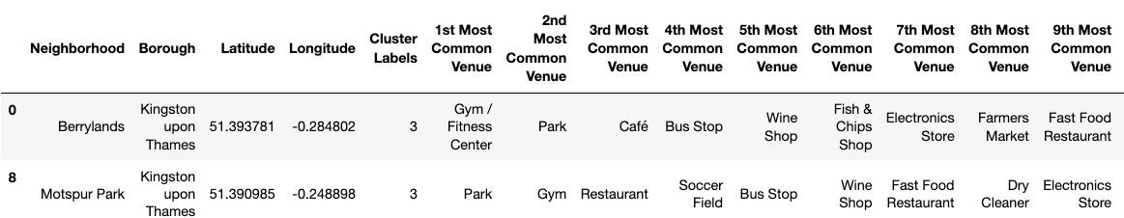
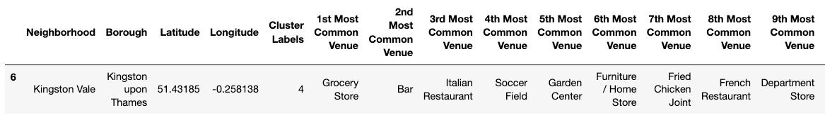
Cluster 4:Looking Into the neighborhoods in the forth Cluster The fourth cluster has two neighborhoods in it, these neighborhoods have common venues such as Parks, Gym/Fitness centers, Bus Stops, Restaurants, Electronics Stores and Soccer fields etc Cluster 5:Looking Into the neighborhoods in the forth Cluster The fifth cluster has one neighborhood which consists of Venues such as Grocery shops, Bars, Restaurants, Furniture shops, and Department stores

Slide 14
Discussion The aim of this project is to help people who want to relocate to the safest borough in London, expats can chose the neighborhoods to which they want to relocate based on the most common venues in it. For example if a person is looking for a neighborhood with good connectivity and public transportation we can see that Clusters 3 and 4 have Train stations and Bus stops as the most common venues. If a person is looking for a neighborhood with stores and restaurants in a close proximity then the neighborhoods in the first cluster is suitable. For a family I feel that the neighborhoods in Cluster 4 are more suitable dues to the common venues in that cluster, these neighborhoods have common venues such as Parks, Gym/Fitness centers, Bus Stops, Restaurants, Electronics Stores and Soccer fields which is ideal for a family. The Preference of venue may vary from person to person . You can select a neighborhoods on one priorities

Slide 15
Conclusion This project helps a person get a better understanding of the neighborhoods with respect to the most common venues in that neighborhood. It is always helpful to make use of technology to stay one step ahead i.e. finding out more about places before moving into a neighborhood We have just taken safety as a primary concern to shortlist the safest borough of London. The future of this project includes taking other factors such as cost of living in the areas into consideration to shortlist the borough, such as filtering areas based on a predefined budget.

Slide 16
Thank You

